Slide 1
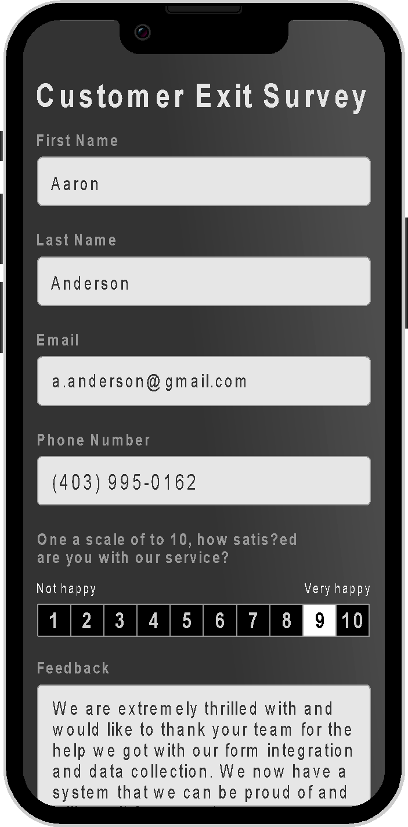

Transforming Customer Interactions
www.wizara.com

Slide 2
Our clients wanted a fast, accurate & secure way to easily manage manual operational workflows.
So, we built AI-powered document automation software so intuitive it revolutionizes workflow management in minutes.

Slide 3

Wizara offers the only genuinely paperless document workflow, & the highest degree of automation and error-free efficiency.
Welcome to

Slide 4






Revolutionize work.
Wizara Form Builder is an intuitive solution for seamless document workflow automation–no technical expertise required.
Wizara’s AI-driven technology allows for efficient, cost-effective operations efficiency across business verticals.
Powerful AI-Assisted Technology
Robust Data Security + Encryption
Mobile-Ready and Responsive
Seamless Backend Integration
User-Friendly Interface - No Code
Extensive Customizable Template Library

Slide 5
Transition paper-based, manual document operations to digital, eliminating the need for printing, filing, sorting and storing physical copies.
Accelerate digital transformation – Wizara offers seamless, cost-efficient implementation.
Eliminate third—party costs and enjoy immediate time and penalty reductions.
Build complex lead generation tools, online polls, and questionnaires effortlessly. Add custom surveys to any website.
Effortlessly collect valuable data from audiences, customers, or users across all digital touchpoints with your seamless form integration solution.
A study by UNLV found that humans empowered by automation technology are over twenty times more accurate at data verification than humans alone.
Current State.
Inefficient Workflows
High Probability of Error
Revenue Loss and Penalty
Non-Compliance
Poor Customer Interaction
No Analytics

Slide 6
The value of accurate data is at an all-time high, and the cost of mistakes has never been more significant.
Human errors burden manual forms and data entry processes, causing duplication, inefficiency, lost profit, non-compliance, and penalties.
“According to a PwC study of CEOs, 40% of business leaders are concerned [human errors] increases the risk of their organization not complying with relevant laws and regulations.”
“Research suggests that the probability of errors in manual data entry ranges from 1% to 40%.”
“Bad data costs U.S. businesses more than $3.1 trillion a year alone, according to a report from IBM.”
Notes:
Sources:
Harvard Business Review
https://hbr.org/2016/09/bad-data-costs-the-u-s-3-trillion-per-year

Slide 7
Seventy percent of respondents say their organizations are at least piloting automation technologies in one or more business units or functions, up from 66 percent in 2020 and 57 percent in 2018.
McKinsey.com
July 2022
The Market.
The Global Mobile Forms Automation Software Market size was valued at USD 290.35 million in 2022 and is expected to expand at a compound annual growth rate (CAGR) of 9.89% during the forecast period, hitting 511.24 million by 2028.
Rising workloads and increasing data management push the sales of form automation software market that includes building and deploying workflows, automating the recurring manual tasks.
Other factors behind the growth of the form automation software market are the rapid digitization and increasing interaction of new-age technologies with automation software.
FutureMarketingInsights.com
July 2022
511.24 M
CAGR 9.89%
Notes:
Sources:
https://www.businessresearchinsights.com/market-reports/mobile-forms-automation-software-market-102399
https://www.mckinsey.com/capabilities/operations/our-insights/your-questions-about-automation-answered
https://www.futuremarketinsights.com/reports/form-automation-software-market

Slide 8
Driven
By Innovation.
Daryl Maksymec
Daryl is the visionary and brain behind Wizara. Keeping the user experience at the forefront, Daryl leads his team to craft solutions using a blend of technical mastery and creative artistry to simplify digital adoption while enabling the endless possibilities of transformative technologies.
Josh Kellendonk
Cloud Solutions Architect with 15 years of experience across multiple industries, Joshua Kellendonk stands at the forefront of the cloud computing space, championing the adoption and optimization of cloud-native solutions. Adept in AWS and Azure ecosystems, Joshua's mastery in creating robust, scalable cloud infrastructures and CI/CD pipelines has powered numerous businesses into the cloud era. His proficiency in Kubernetes, containerization, and serverless architectures has not only revolutionized customer applications but also enhanced team agility and product resilience. With a recent pivot towards leveraging AI to build advanced, intelligent solutions, Joshua's innovative approach is steering cloud technologies towards a future of augmented capabilities and unprecedented efficiency. His passion for technology, coupled with a relentless commitment to customer value, makes him an invaluable asset to any forward-thinking enterprise.
Meet the team who embody the magic of human imagination combined with the power of technology.
More than a collection of highly-skilled individuals – we're a spirited ensemble passionate about crafting seamless solutions that transform how the world leverages technology.
Eli Kellendonk
Eli is the Lead Software Developer at Wizara with a decade of experience in full-stack development, specializing in technologies like TypeScript, JavaScript, PHP, Java, React, and Next.js. Skilled in Agile project management and software architecture, he efficiently translates complex requirements into clean, maintainable code. Eli excels in database management and cloud computing, utilizing platforms such as AWS, Azure, and Google Cloud to deliver scalable and resilient software solutions that power Wizara’s innovation.
Scott McIndless
Scott has played an integral role with some of Canada’s largest financial services companies, including Canada Life, The Co-Operators Group and Heritage Funds, where he rose to Chairman, overseeing over $2.7 billion in assets. With over 35 years of expertise in entrepreneurship, strategic business development, marketing and business planning, he uses his unique business acumen to facilitate Wizara’s full potential.
Notes:
Sources:
https://www.wizara.com/our-team

Slide 9
The Opportunity.
Use of Funds
Wizara AI Inc. is a purpose-based software development entity created to develop, market and expand the Wizara automation software tool.
Wizara isn’t a start-up. It’s market-ready and already setting the pace for digital transformation. At the forefront of the growing mobile, web and cloud automation market, Wizara harnesses the power of AI for businesses to optimize efficiency, customer interaction and profitability.
Team Development
Product Technology Advancement
Accelerate
Growth
Facilitate Marketing Launch
See Wizara in Action
www.wizara.com

